Slide 1
Middle Eastern and North African Visual Arts
An Overview

Slide 2
Major Visual Arts of the Middle East and North Africa
Architecture
Sculpture
Painting
Calligraphy

Slide 3
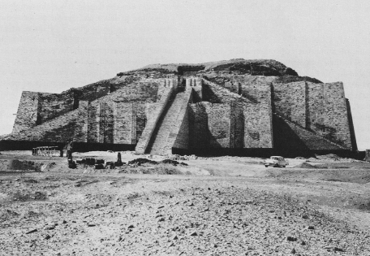
Mesopotamian Architecture
Work: Ziggurat of Ur
Source Culture: Sumer

Slide 4
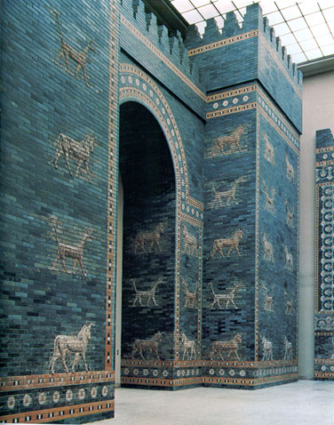
Mesopotamian Architecture (continued)
Work: Ishtar Gate
Source Culture: Babylonia

Slide 5
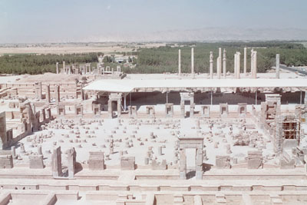
Mesopotamian Architecture (continued)
Work: Palace of Darius and Xerxes at Persepolis
Source Culture: Persia

Slide 6
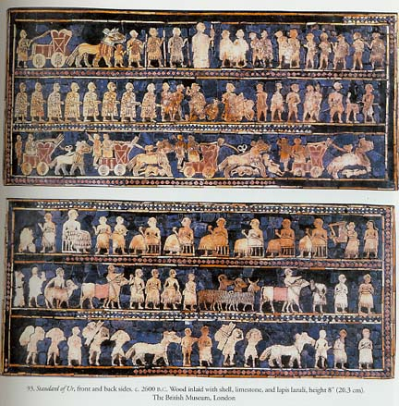
Mesopotamian Sculpture
Work: Standard of Ur
Source Culture: Sumer

Slide 7
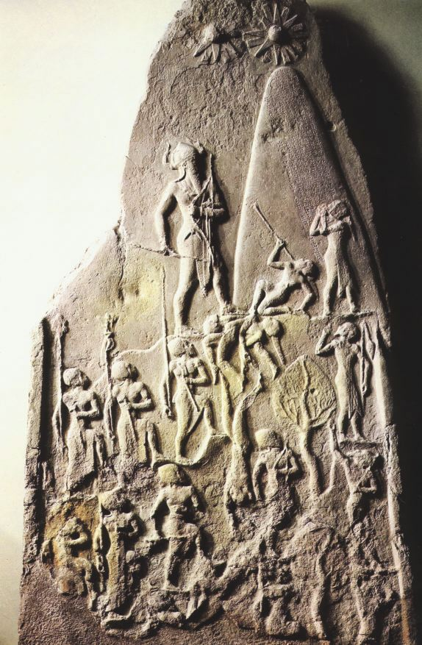
Mesopotamian Sculpture (continued)
Work: Victory Stele of Naram-Sin
Source Culture: Akkad

Slide 8
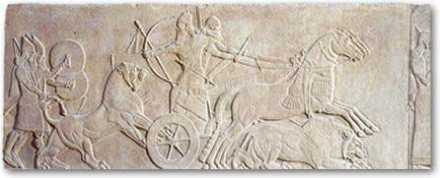
Mesopotamian Sculpture (continued)
Work: Ashurnasirpal II Killing Lions
Source Culture: Assyria

Slide 9
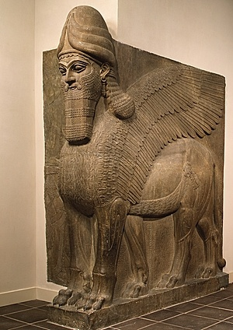
Mesopotamian Sculpture (continued)
Work: Human-Headed Winged Lion
Source Culture: Assyria

Slide 10
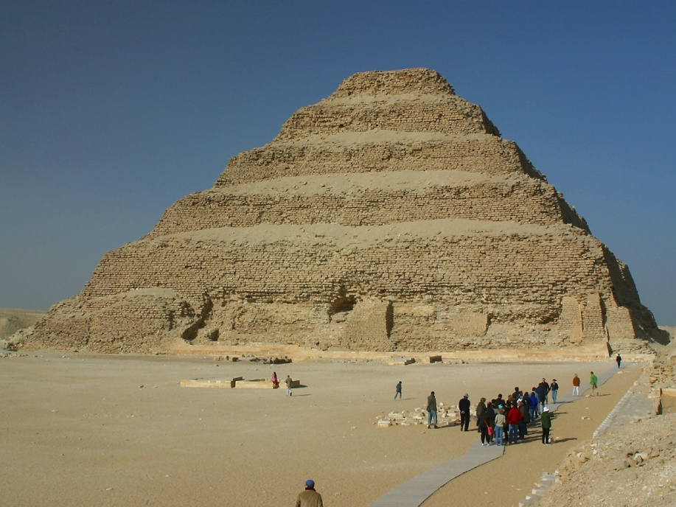
Egyptian Architecture
Work: Stepped Pyramid of Zoser

Slide 11
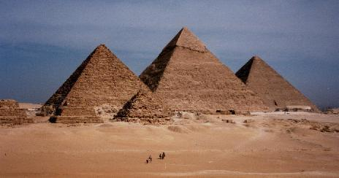
Egyptian Architecture (continued)
Work: Great Pyramids at Giza

Slide 12
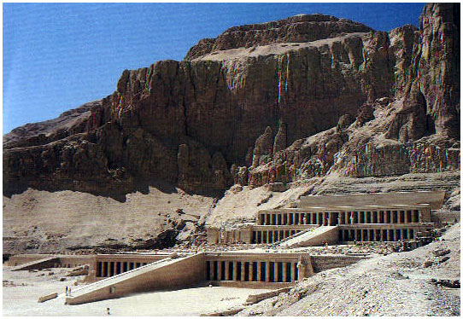
Egyptian Architecture (continued)
Work: Funerary Temple of Queen Hatshepsut

Slide 13
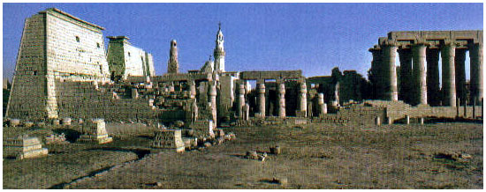
Egyptian Architecture (continued)
Work: Temple of Amen-Mut-Khonsu

Slide 14
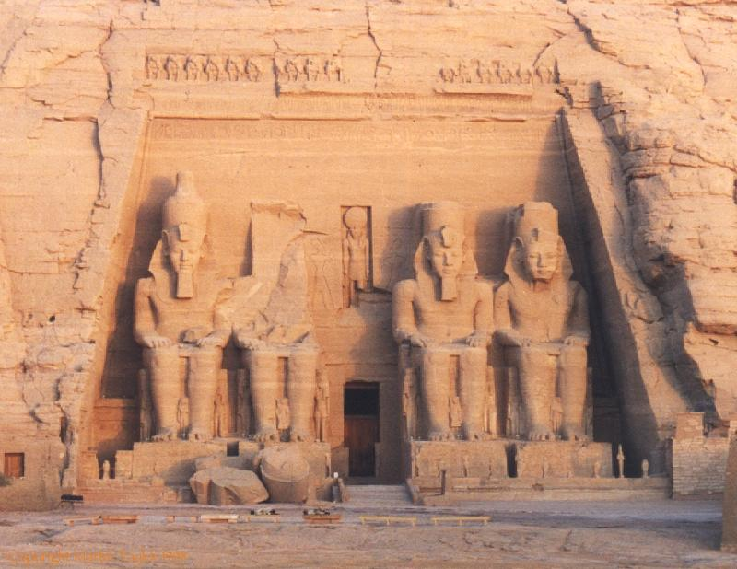
Egyptian Architecture (continued)
Work: Temple of Ramses II at Abu Simbel

Slide 15
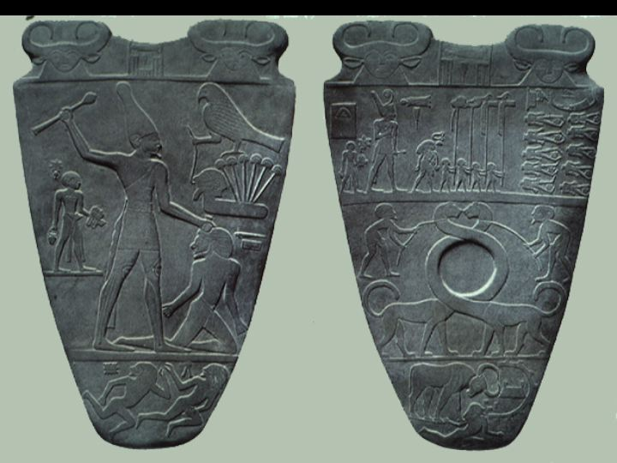
Egyptian Sculpture
Work: Palette of Narmer

Slide 16
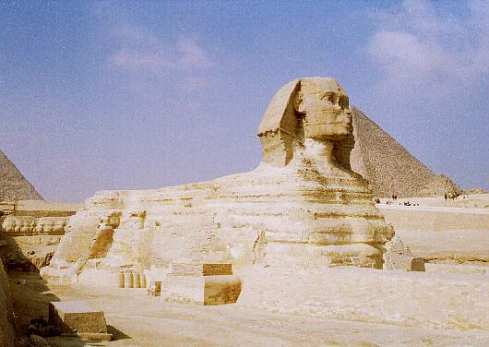
Egyptian Sculpture (continued)
Work: Great Sphinx at Giza

Slide 17
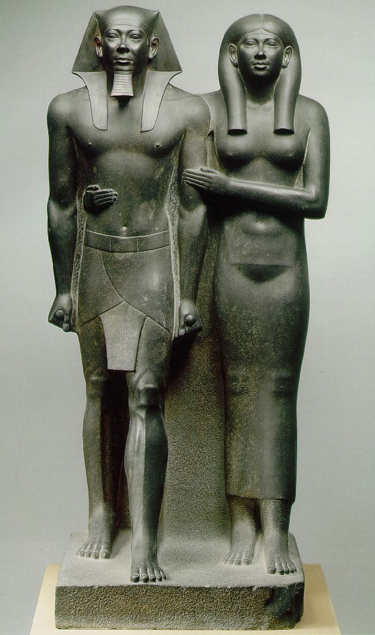
Egyptian Sculpture (continued)
Work: Menkaure and Khamerernebty

Slide 18
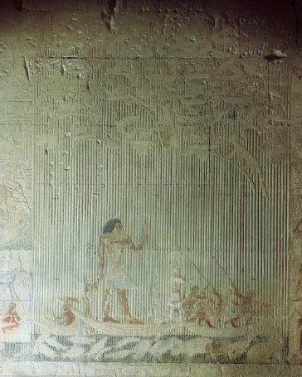
Egyptian Sculpture (continued)
Work: Ti Watching a Hippopotamus Hunt

Slide 19
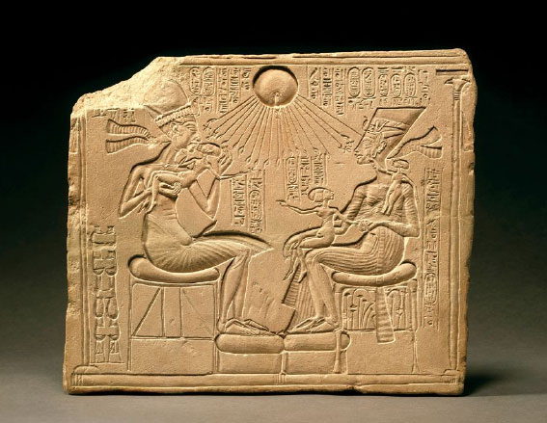
Egyptian Sculpture (continued)
Work: Akhenaten, Nefertiti, and Their Children Worshipping the Sun

Slide 20
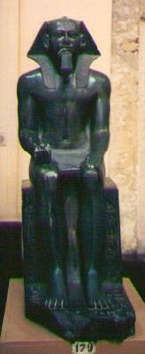
Egyptian Sculpture (continued)
Work: Chefren

Slide 21
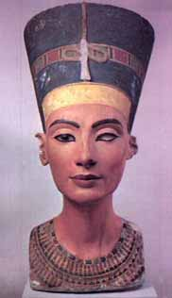
Egyptian Sculpture (continued)
Work: Queen Nefertiti

Slide 22
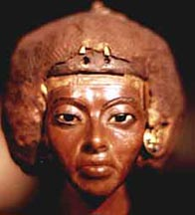
Egyptian Sculpture (continued)
Work: Queen Tiy

Slide 23
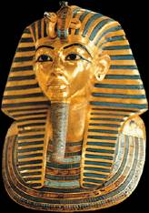
Egyptian Sculpture (continued)
Work: Funeral Mask of Tutankhamen

Slide 24
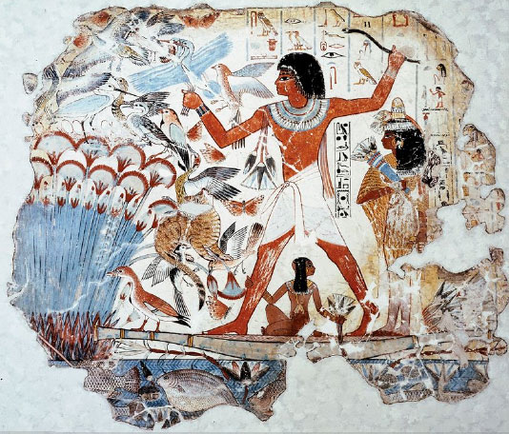
Egyptian Painting
Work: Nobleman Hunting in the Marshes

Slide 25
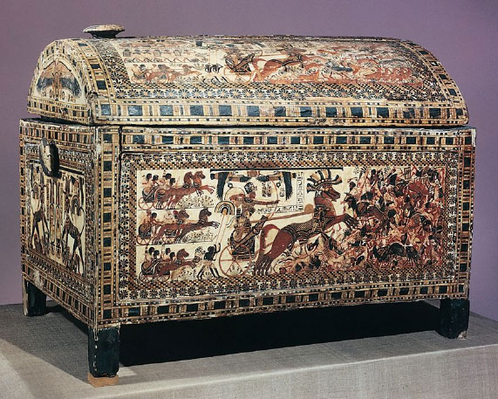
Egyptian Painting (continued)
Work: Painted Chest from the Tomb of Tutankhamen

Slide 26
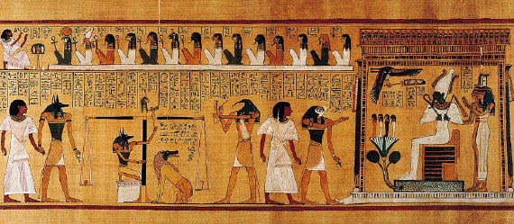
Egyptian Painting (continued)
Work: Last Judgment of Hu-Nefer

Slide 27
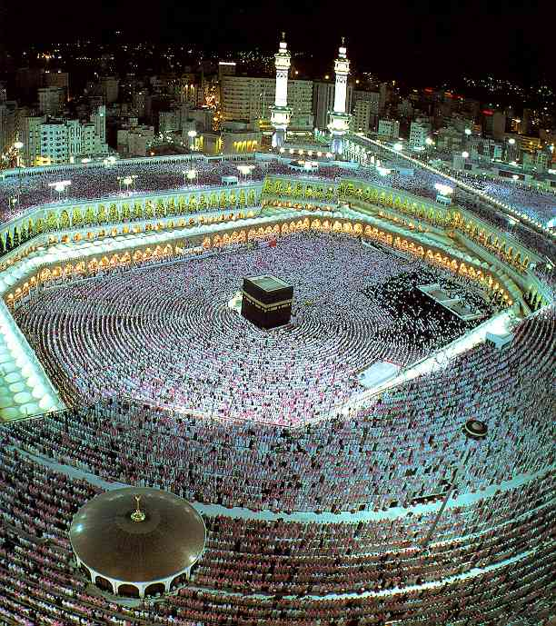
Islamic Architecture
Work: Grand Mosque in Mecca (contains the Kaaba)

Slide 28
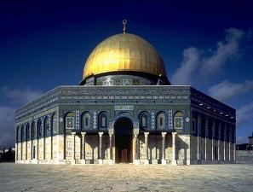
Islamic Architecture (continued)
Work: Dome of the Rock

Slide 29
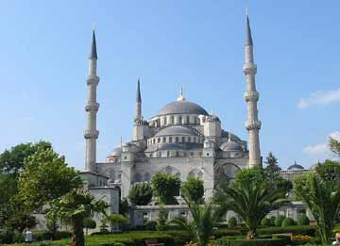
Islamic Architecture (continued)
Work: The Blue Mosque

Slide 30
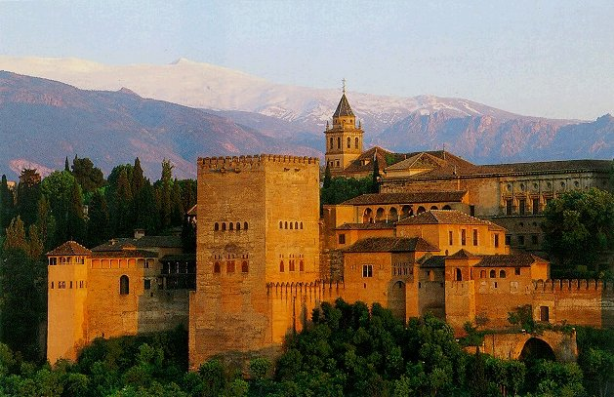
Islamic Architecture (continued)
Work: The Alhambra

Slide 31
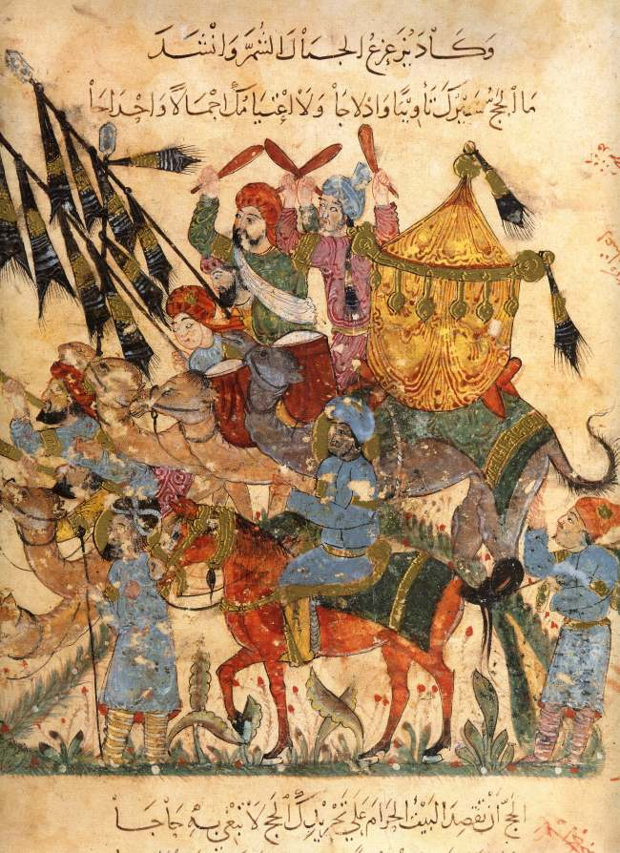
Persian Illuminated Manuscripts
Work: Maqamat of al-Hariri

Slide 32
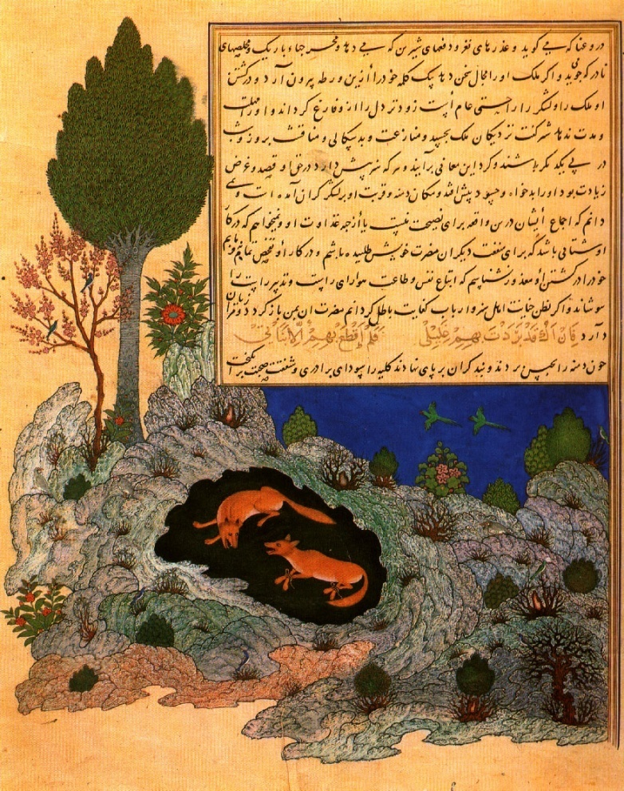
Persian Illuminated Manuscripts (continued)
Work: Kalila wa Dimna

Slide 33
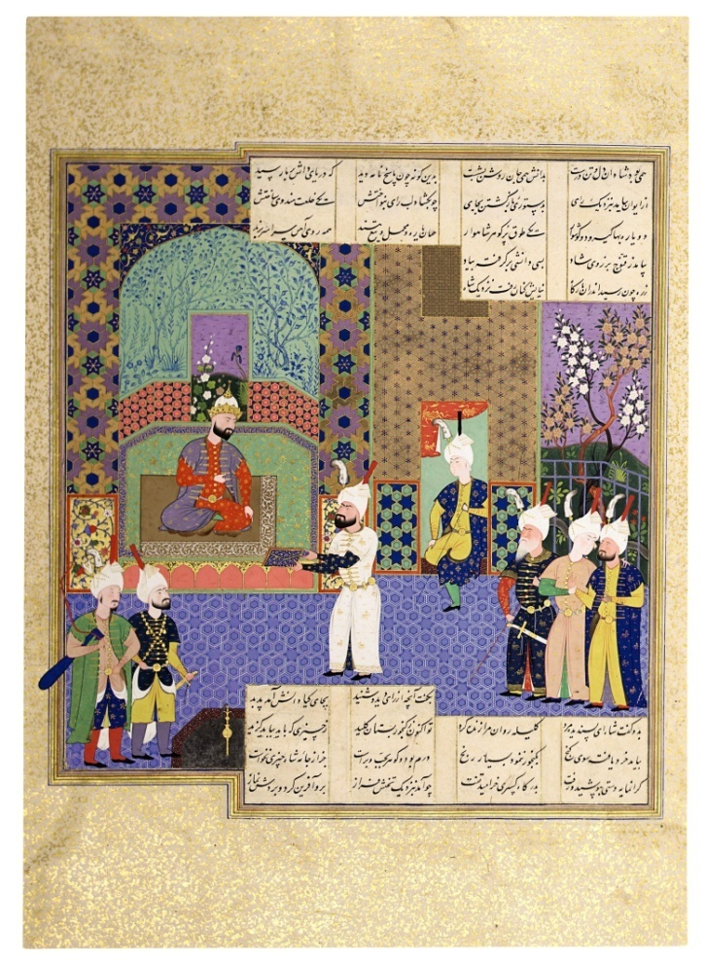
Persian Illuminated Manuscripts (continued)
Work: Shahnama

